Slide 1

Data Analysis Essentials Cornerstone Project
First Review
Web Based Product Tracking System
Presented by
G Akshaya (25B11AI328)
R Thanuja (25B11AIA34)
Y Aasmita (25B11AID10)
Department of Artificial Intelligence & Machine Learning

Slide 2




Presentation Outline
Abstract
Introduction
Analysis
Requirements
Methodology
Conclusion

Slide 3
ABSTRACT
A Web - Based Product Tracking System is an online application designed to monitor and manage products throughout their lifecycle, from manufacturing or purchase to delivery and sales. The system helps businesses keep accurate records of product details, stock levels, locations,and movement in real time. It provides features such as product registration, inventory management, order tracking,and report generation .
Users can securely access the system through a web browser, making it easy to update and track product information from anywhere. This system reduces manual errors, improves inventory accuracy, saves time, and enhances overall business efficiency by ensuring smooth product management and better decision - making .

Slide 4
INTRODUCTION
A Web - Based Product Tracking System is an online application used to manage and track products efficiently.
It helps businesses monitor product details, stock levels, and product
movement in real time.
The system stores all product information in a centralized database,
making it easy to access and update
• It reduces manual work, minimizes errors, and improves inventory
management.
• Being web - based, it can be accessed anytime and from anywhere with
an internet connection.
• Overall, the system saves time, increases accuracy, and improves
business efficiency.

Slide 5
ANALYSIS
Existing System
• Data is stored in Excel Sheets, csv Files.
• Data is stored in Excel Sheets, csv Files, or Paper Records.
• Product details are updated manually by employees.
• Tracking product movement is time - consuming and inefficient.
Problems in the Existing System
• Slow processing of product information.
• Human errors during data entry.
• Missing or duplicate product records.
• Difficulty in tracking product location and stock.
• No real - time updates.
• No automatic reports or data visualization.

Slide 6
ANALYSIS
Limitations of Existing System:
Manual data entry increases the chances of errors.
Product information is not updated in real time.
Tracking products takes more time and effort.
It is difficult to manage large amounts of product data.
There are no automatic reports or data visualization features.

Slide 7
ANALYSIS
Proposed System :
Develop a web - based application to manage and track products online.
Store all product information in a centralized database.
Enable real - time product and inventory tracking.
Provide secure login for authorized users.
Generate reports for easy product management.
Advantages of the Proposed System
Reduces manual work and human errors.
Saves time with faster product tracking.
Provides real - time updates on product status.
Improves inventory accuracy and organization.
Easy to access from anywhere using a web browser.

Slide 8
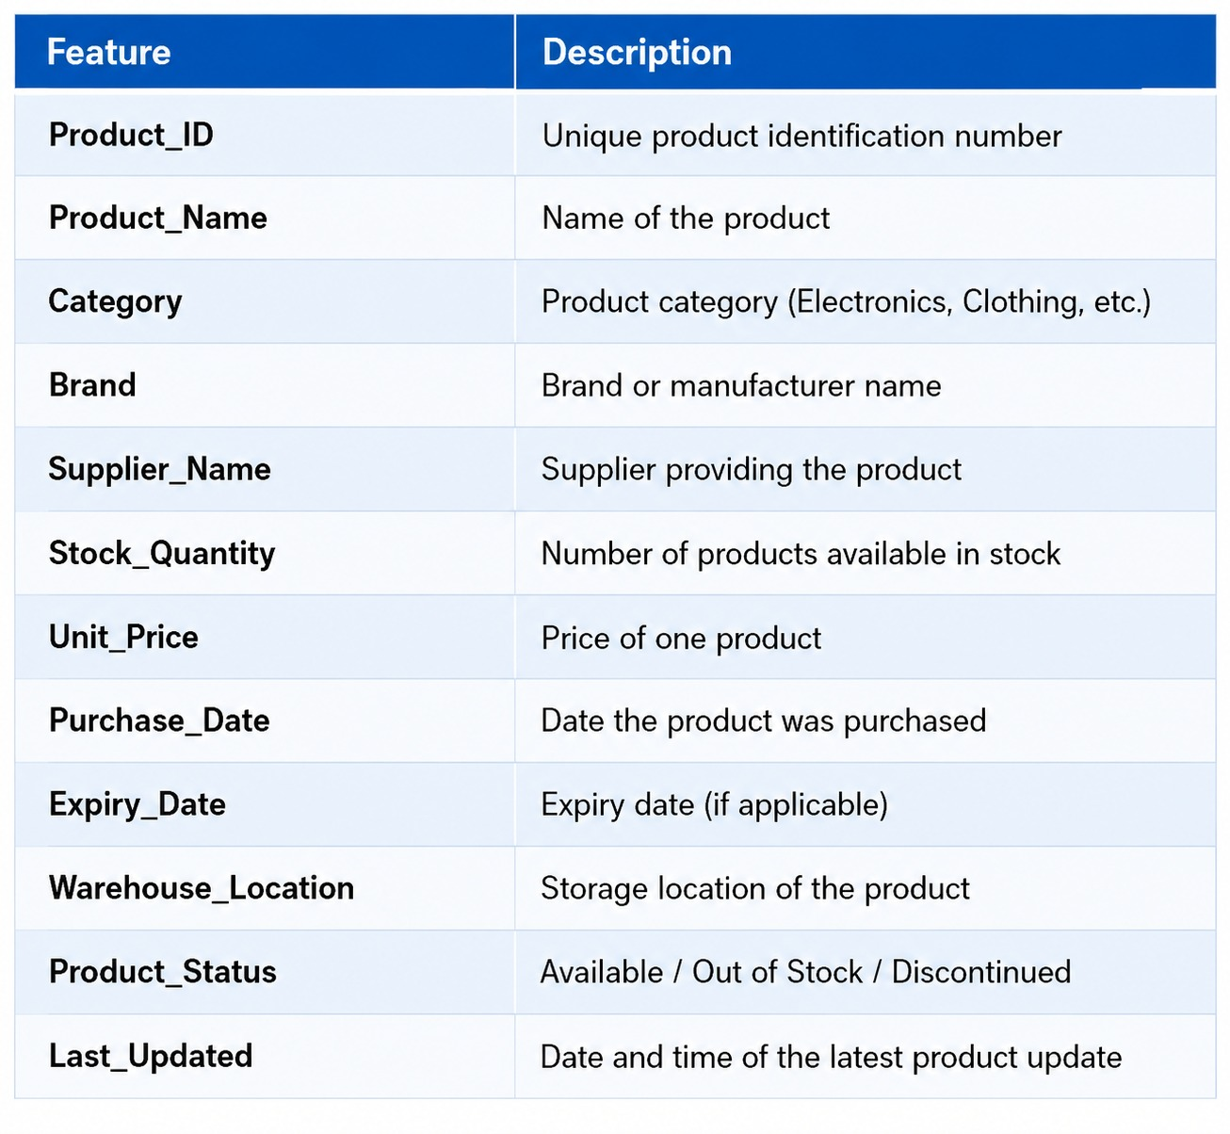
ANALYSIS
DATASET DESCRIPTION

Slide 9
REQUIREMENTS
Hardware Requirements
Processor: Intel i3 or above.
RAM: Minimum 4 GB or Higher.
Hard Disk: 500 GB or SSD.
Internet Connection.
Software Requirements
Operating System: Windows 10/11.
Frontend: HTML, CSS, JavaScript.
Backend: PHP.
Database: MySQL.
Web Server: XAMPP/WAMP.
Browser: Google Chrome or Microsoft Edge.

Slide 10
METHODOLOGY
Modules:
Module 1
* User registration and secure login.
* Role - based access for users and admin.
* Password encryption and session management for security.
Module 2
* Add, update, delete, and view product details.
* Store product information in the database.
* Validate product data to ensure accuracy and consistency.
Module 3
* Track product quantity and stock availability.
* Update inventory automatically after changes.
* Generate alerts for low - stock or out - of- stock items.

Slide 11
METHODOLOGY
Module 4
* Monitor product movement and current status.
* Search products using Product ID or name.
* Maintain history of product transactions and updates
Module 5
* Generate inventory and product reports.
* Display product statistics on the dashboard.
* Provide visual insights using charts and summaries.
Module 6
* Store and manage all product records securely.
* Maintain data accuracy and enable quick retrieval.
* Ensure regular backups and data recovery support.

Slide 12
EXPECTED OUTPUTS
Easy and accurate product tracking.
Real- time updates of product and stock details.
Reduced manual work and fewer errors.
Faster product search and inventory management.
Secure storage of product information.
Automatic report generation for better decision - making.
Improved overall business efficiency.

Slide 13
CONCLUSION
The Web - Based Product Tracking System provides a simple and efficient way to manage and track products
online.
It reduces manual work, improves data accuracy, and
offers real - time product updates. The system saves time, enhances inventory management, and helps businesses make better decisions.
Overall, it is a reliable, user - friendly, and effective solution for modern product tracking.

Slide 14
THANK YOU

